Slide 1

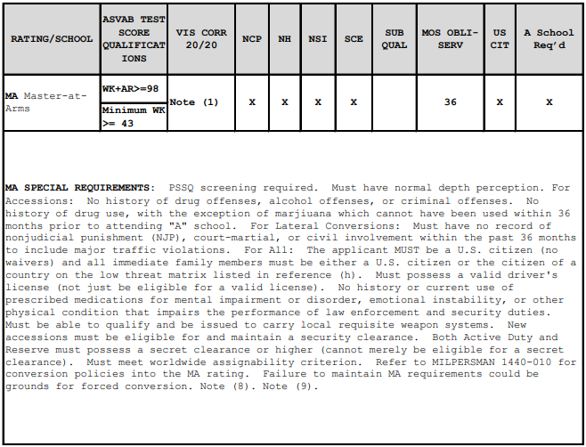
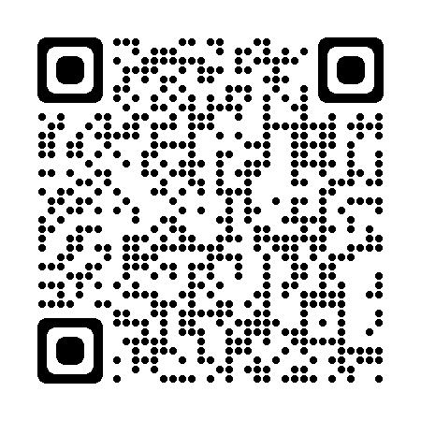
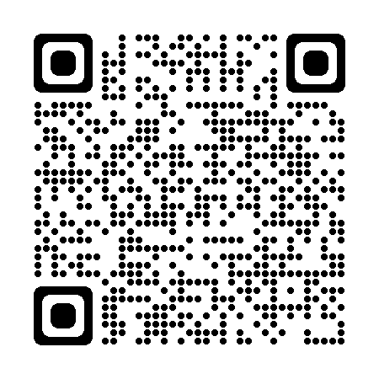
MA
VE+AR+MK+MC = 188
PSSQ screening required. Must have normal depth perception. For Accessions: No history of drug offenses, alcohol offenses, or criminal offenses. No history of drug use, with the exception of marijuana. For Lateral Conversions: Must have no record of non-judicial punishment (NJP), court-martial, or civil involvement within the past 36 months to include major traffic violations. For All: The applicant MUST be a U.S. citizen (no waivers) and all immediate family members must be either a U.S. citizen or the citizen of a country on the low threat matrix listed in reference (h). Must possess a valid driver's license (not just be eligible for a valid license). No current use of prescribed medications for mental impairment or disorder, emotional instability, or other physical condition that impairs the performance of law enforcement and security duties within the past 36 months. Must be able to qualify and be issued to carry local requisite weapon systems. New accessions must be eligible for and maintain a security clearance. Both Active Duty and Reserve must possess a secret clearance or higher (cannot merely be eligible for a secret clearance). Must meet worldwide assignability criterion. Refer to MILPERSMAN 1440-010 for conversion policies into the MA rating. Failure to maintain MA requirements could be grounds for forced conversion. Note (8). Note (9).

